Slide 1


NEXT GEN EMPLOYABILITY PROGRAM
CREATING A FUTURE-READY WORKFORCE
Student Name :
RONTALA POOJA REDDY
Student ID :
STU6422f769acb711680013161
Mobile No:
6309013154
Mail ID:
2103a51067@sru.edu.in
College Name :
SR UNIVERSITY

Slide 2
CAPSTONE PROJECT SHOWCASE
Project Title
Trends and Insights in the Indian Agriculture Sector through Power BI Analysis
Abstract | Problem Statement | Project Overview | Proposed Solution | Technology Used | Modelling & Results | Conclusion | Q&A

Slide 3
Abstract
1
Data Visualization, Dashboard Creation, and Interactive Reporting
2
The slicers and graphs are related to the data
3
Minimum Supporting Price Estimating
4
Derive Insights From The Data.

Slide 4


Problem Statement
TO Known The Sum of Production by Crop
Crop Count
State Count
Season Count
Years Count
Agricultural experts, Farmers, and other stakeholders with actionable insights that drive informed decision-making.
The Agriculture Sector Faces Multifaceted Challenges Ranging from Crop and Year .

Slide 5

Project Overview
Data Aggregation
Utilize Power BI's capabilities to create interactive dashboards and visualizations that enable stakeholders to explore in data
Gather datasets from various sources
Cleanse, preprocess, and standardize the collected datasets
Analysis and Visualization
Provide stakeholders with actionable insights to drive informed decision-making
Stakeholders to Identify and Implement Strategies that enhance Productivity
Farmers and Rural Communities with Knowledge and Tools that enable them to adapt to changing Market Dynamics

Slide 6

Proposed Solution
Utilize Power BI's intuitive interface and powerful analytical capabilities to create interactive dashboards, reports, and visualizations.
Design user-friendly interfaces with slicers, filters, and drill-down functionalities to enable stakeholders to explore and analyze data dynamically.
Statistical analysis techniques to identify trends, correlations, and patterns within the data.
Employ machine learning algorithms for predictive analytics, such as crop yields based on historical production data and weather in particular State patterns.

Slide 7
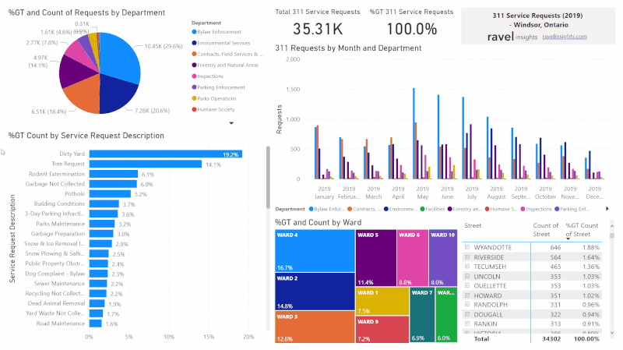
Technology used
Data Collection and Integration Tools
Database Management Systems (DBMS)
Power BI
Statistical Analysis
Collaboration Tools
Data Security Measures

Slide 8
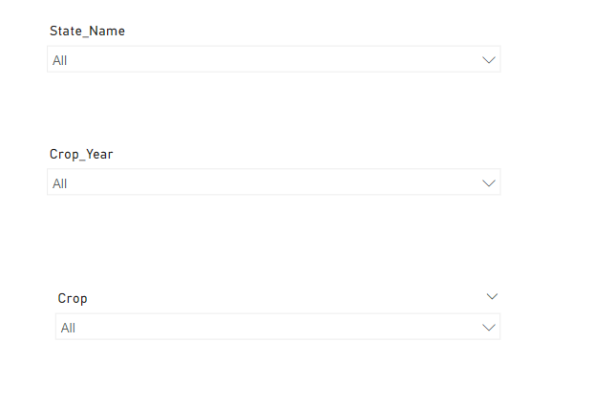
Modelling & Result

Slide 9
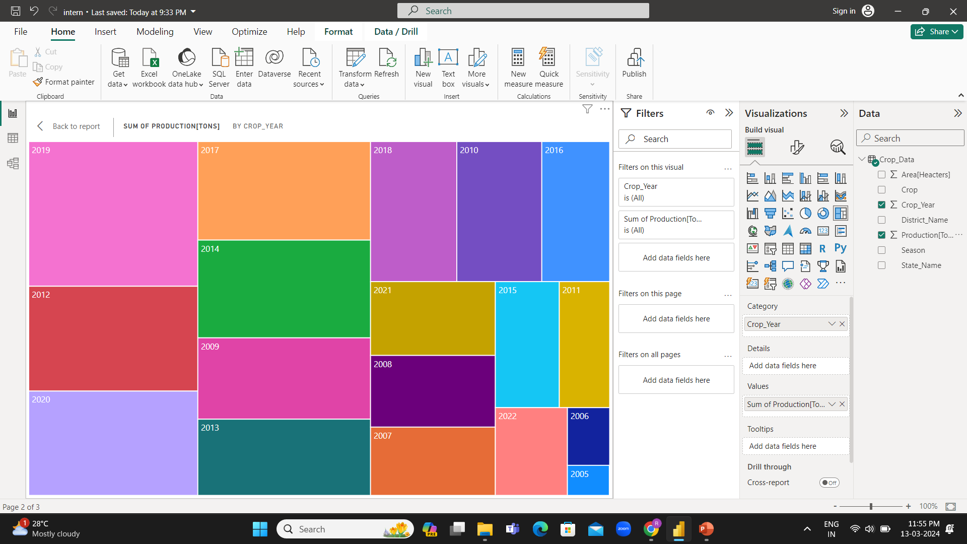
Modelling & Result

Slide 10
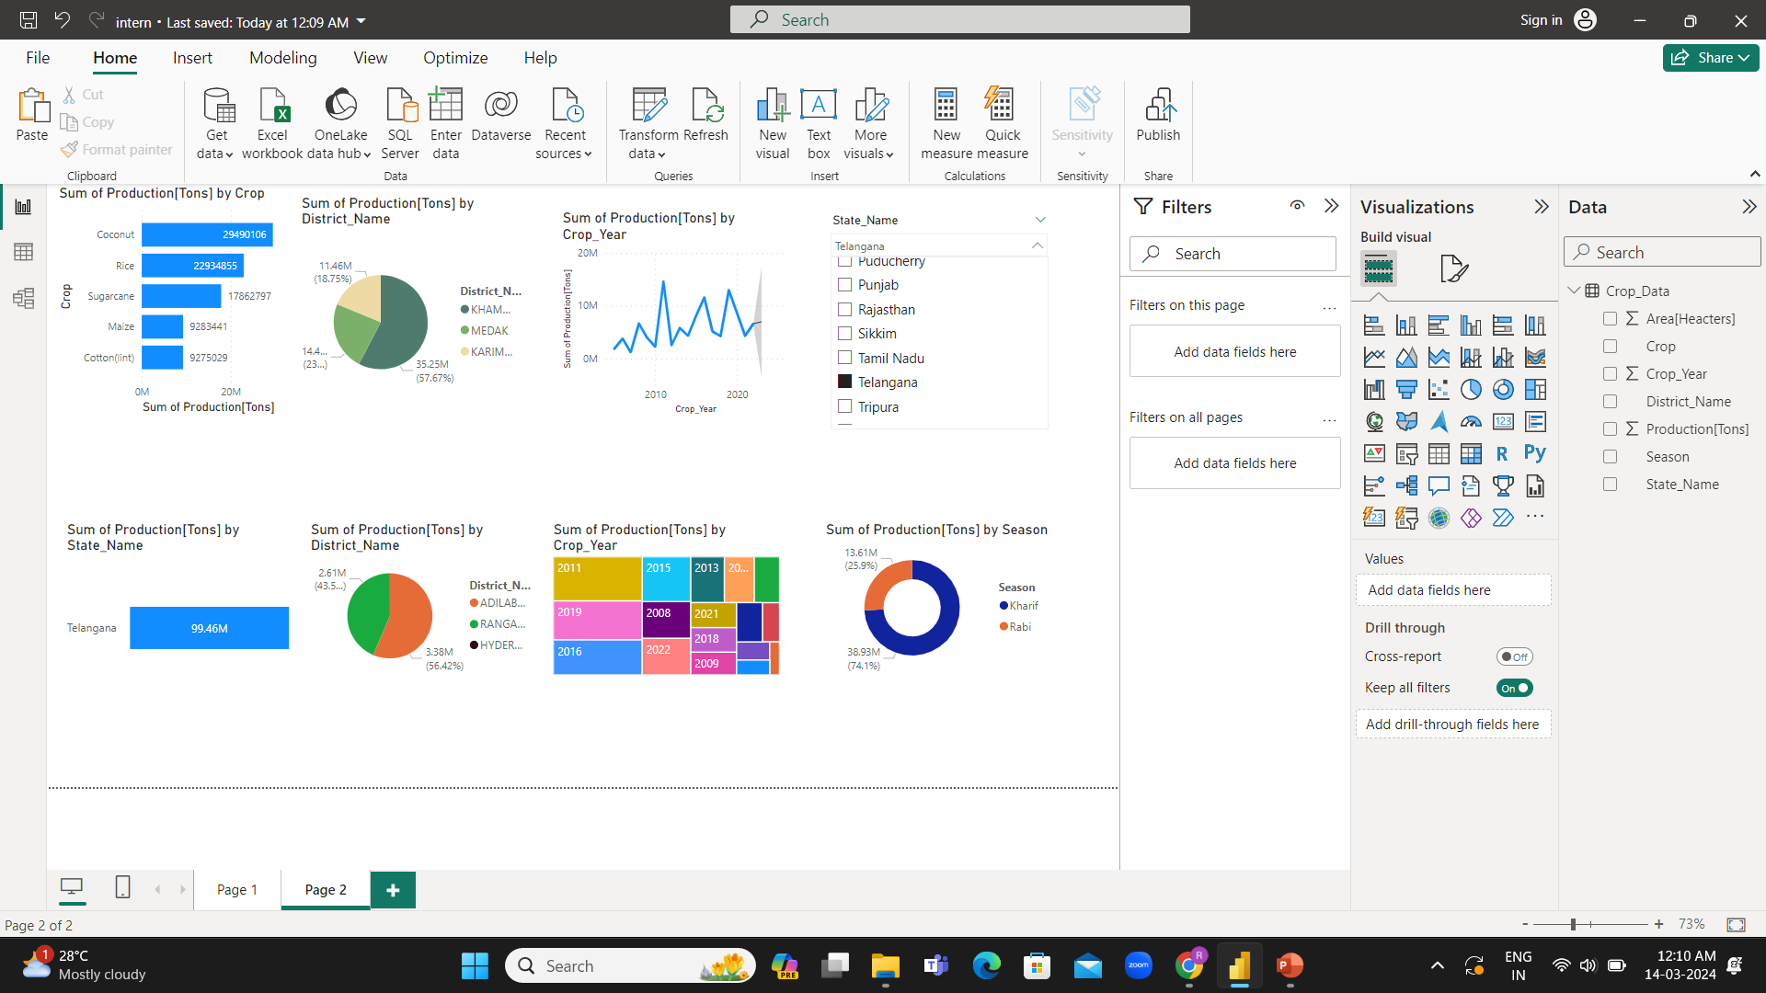
Modelling & Result

Slide 11
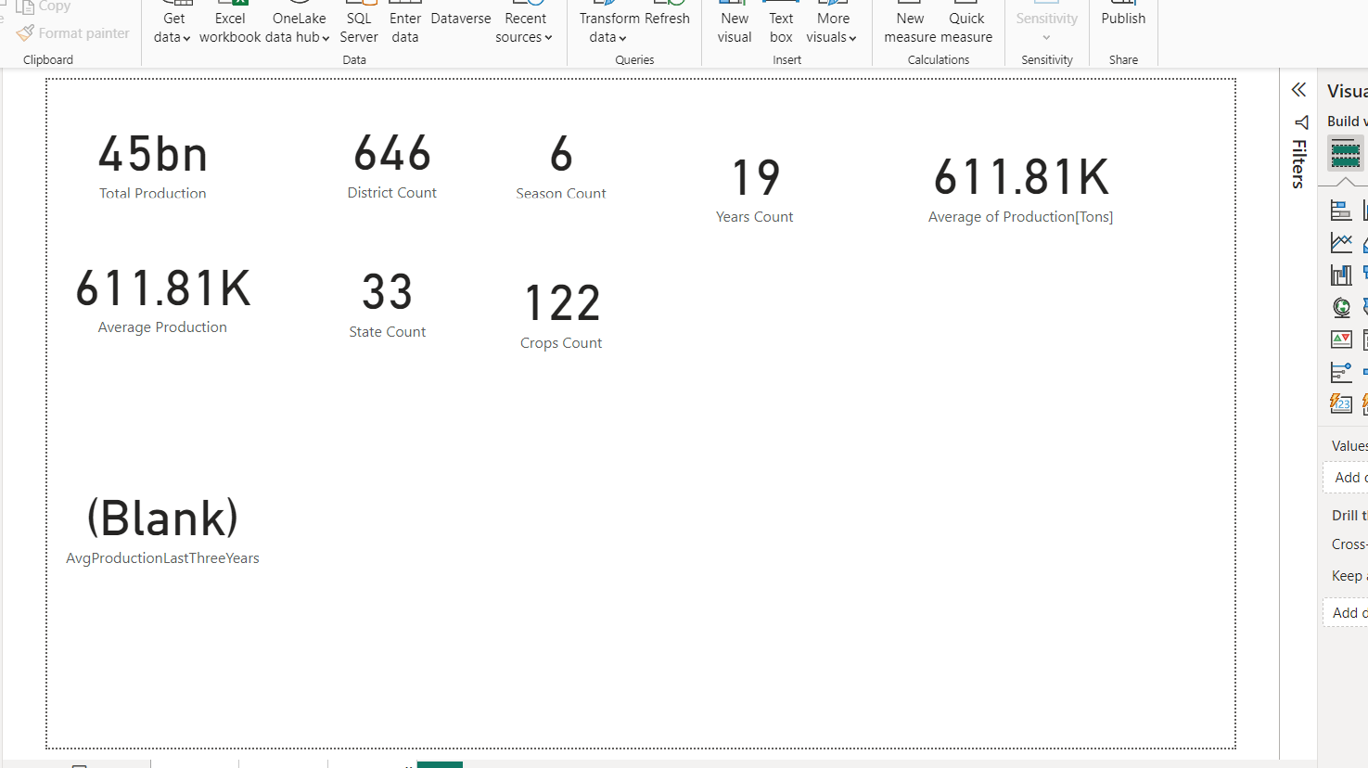
Modelling & Result

Slide 12
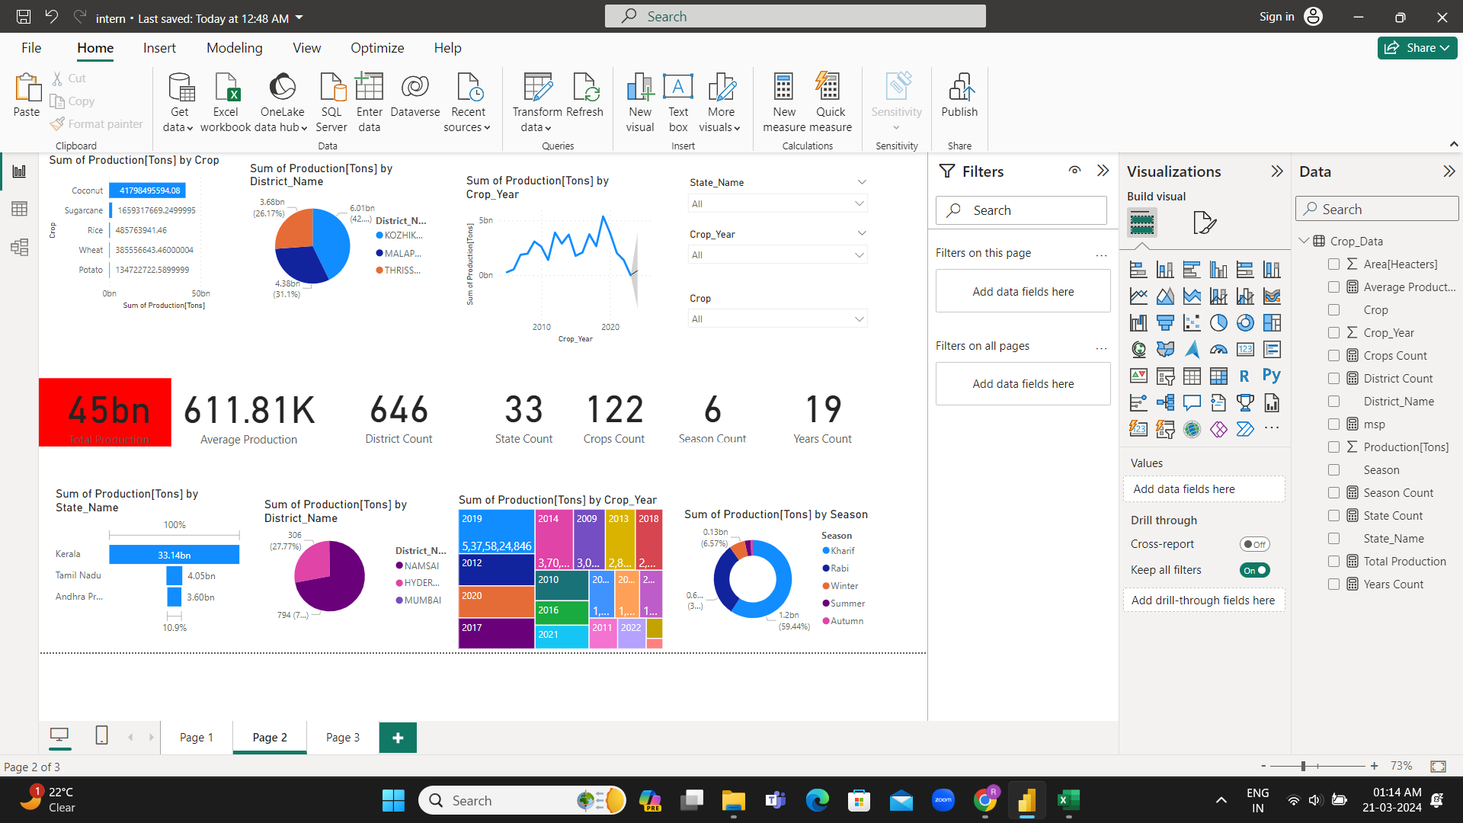
Modelling & Result

Slide 13
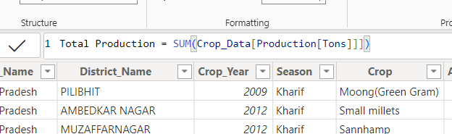
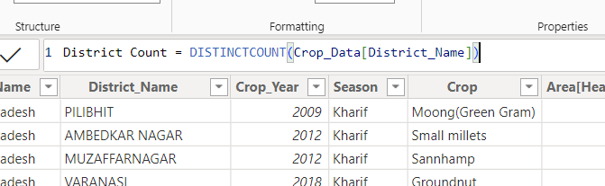
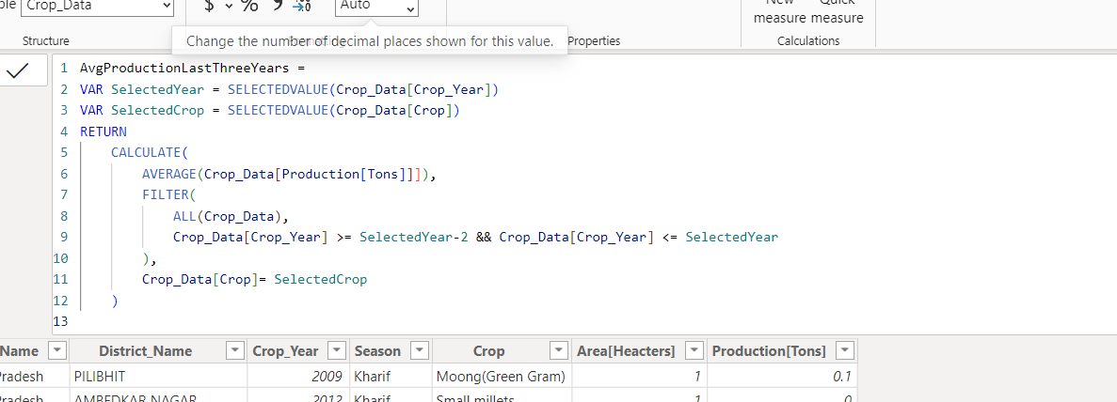
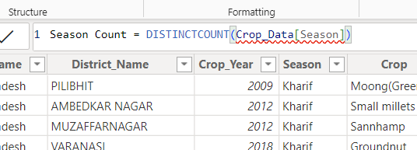
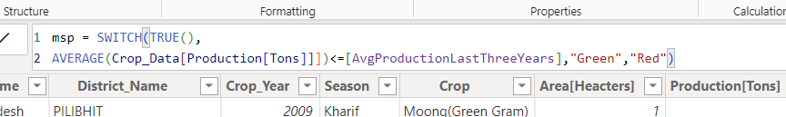
Modelling & Result

Slide 14
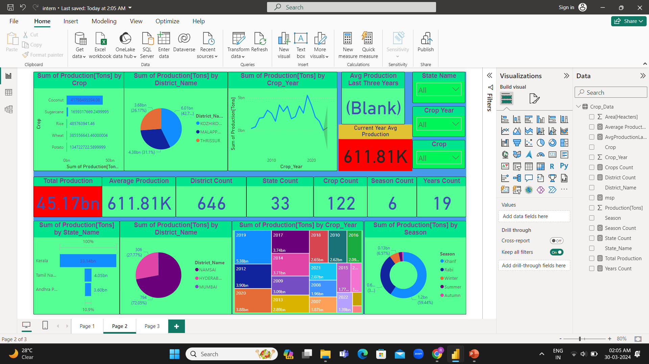
Modelling & Result

Slide 15
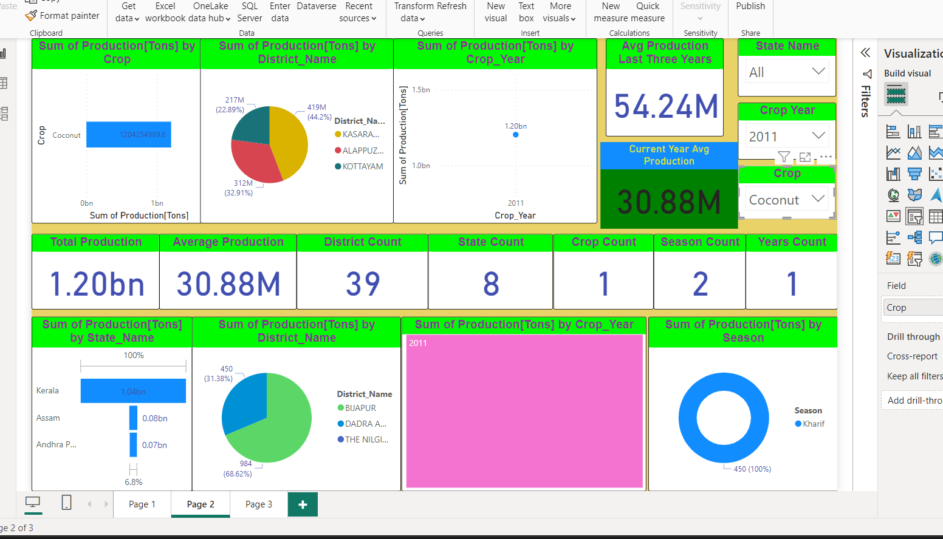
Modelling & Result

Slide 16
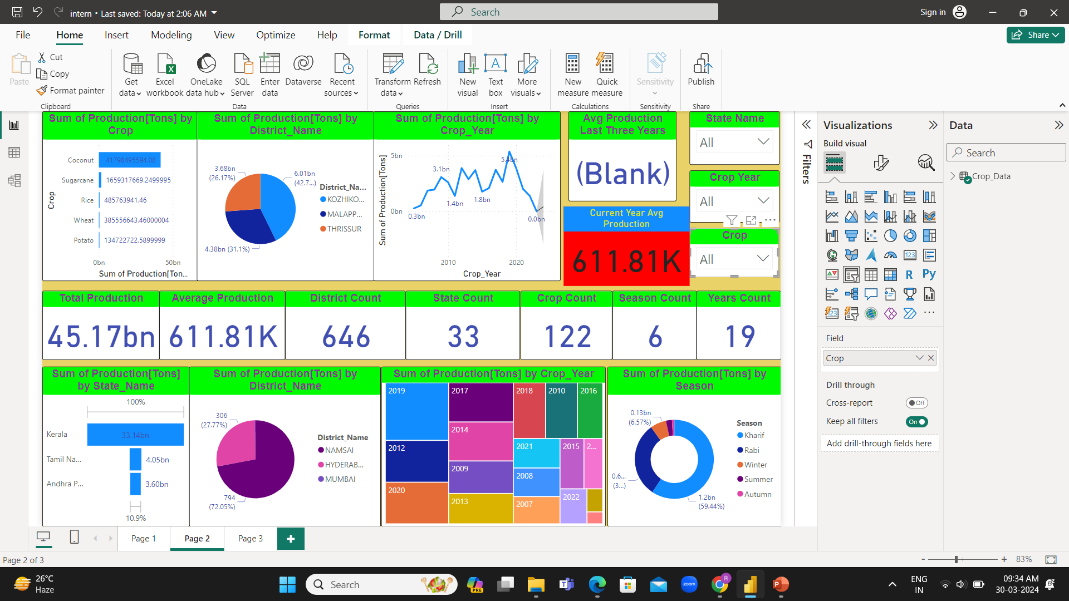
Modelling & Result

Slide 17


Conclusion
The proposed solution offers a holistic approach to address the challenges faced by the Indian agriculture sector through the utilization of Power BI and complementary technologies. By aggregating, integrating, and analyzing diverse datasets, stakeholders can gain valuable insights into various aspects of the agriculture sector. The implementation of Power BI provides an intuitive and interactive platform for stakeholders to explore data dynamically, enabling informed decision-making and strategic planning. Through advanced analytics techniques.

Slide 18


Notes:
Thank You !!

